Slide 1
I WETLANDS

Slide 2
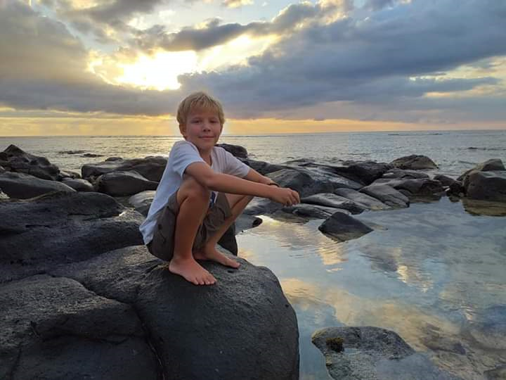
Hello, my name is Fred and I am 10 years old and I wetlands.
I have made this presentation to tell you about wetlands as I think you might love them too.

Slide 3
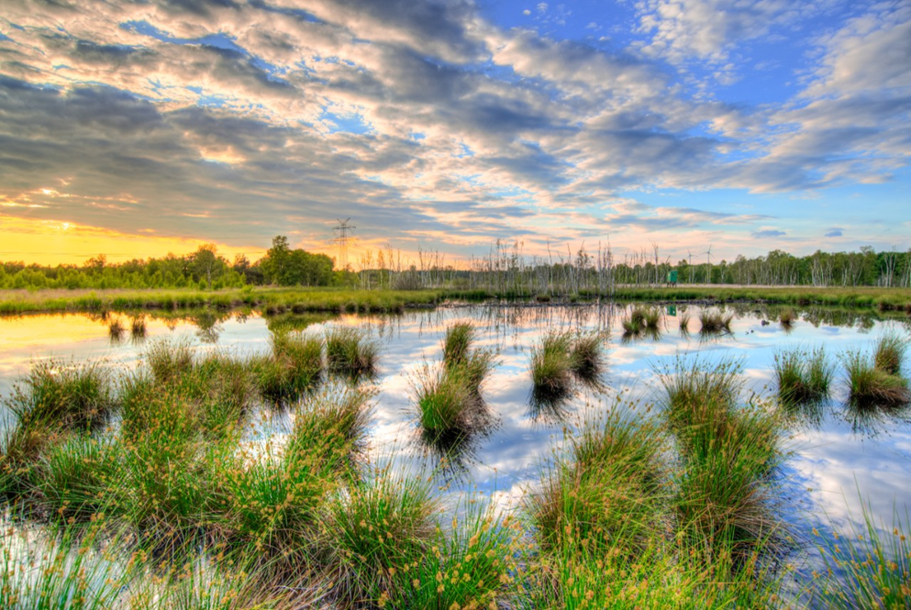
Wetlands are a really important habitat.
Wetlands are, simply put, the place where land meets water. They can be coastal or inland.
There are an amazing variety of wetlands - marshes, peat bogs, wet woodlands, floodplains, deltas, mangroves, and coral reefs they are all wetlands.

Slide 4
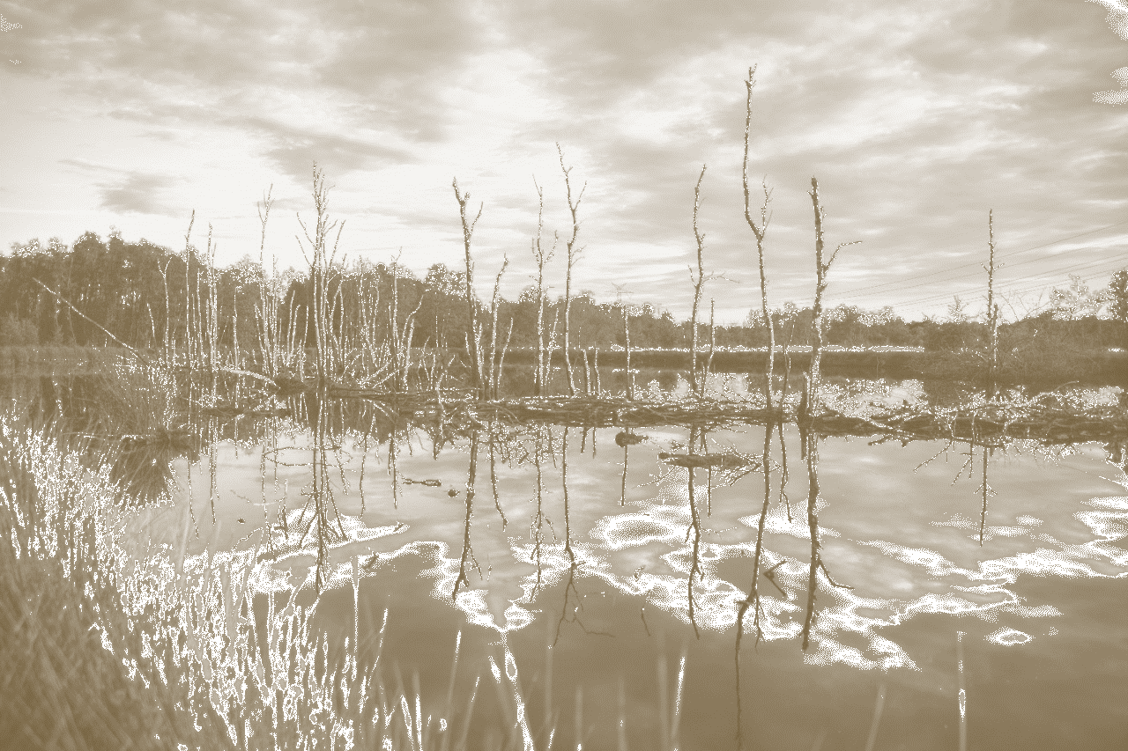
There are many reasons why wetlands are important:
One is the amazing biodiversity found in wetlands. 40% of life on earth, or 150,000 species, depend on freshwater wetlands.
Wetlands store a third of the world’s carbon, more than the worlds rainforests, and are therefore a major contributor to the means by which we can reverse climate change.
Wetlands also support a billion people – people’s work depends on wetlands, or they find their food there, or even valuable materials to build shelter.
Despite all this, wetlands are seen as having little or no value unless drained. Only 1% of mangroves have any protection and the world is losing wetlands at a rate three times faster than forests.
(https://www.wwt.org.uk/our-work/why-wetlands )

Slide 5
The Sustainable Development goals:
These are a set of really important goals the United Nations developed with every country in the world to help the world solve some of the biggest problems we face today. Everything from access to education, climate change, peace and justice…its all in there…..
But not wetlands!

Slide 6
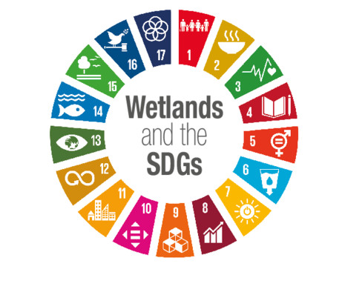
BUT Without wetlands we cannot meet the SDG’s

Slide 7
Wetlands are not only crucial to the environment, they are also crucial to achieving lots of other goals. For example:
SDG 7.Affordable and clean energy
Sustainable upstream water management can provide affordable and clean energy
SDG 1.No poverty
More than a billion people depend on wetlands. Destroying wetlands would push many more people into poverty.
SDG 5.Gender equality
Women play a central role in the provision, management and safeguarding of water. Wetlands play a valuable role in giving women employment and a source of income.
SDG 15.Life on land
40% of all the worlds species live and breed in the wetlands
SDG 3.Good health and well being
Half of international tourists seek relaxation in wetland areas, especially coastal zones.

Slide 8
IN FACT, Without Wetlands things will get worse - disaster mitigation
Coastal ecosystems are the biggest factors in disaster mitigation. Wetlands provide $5 million flood mitigation each year. In the 2004 Indian Ocean tsunami, coastal communities with healthy coastal ecosystems fared better than ones that destroyed them. Wetlands are not the only disaster mitigators along the coast. Mangroves absorb 70-90% of wind-generated waves. Coral reefs provide protection of coastal communities worth $9 million. In total coastal ecosystems provide $14 million worth of disaster mitigation.
What is Disaster Mitigation?
Disaster mitigation is the ability to prevent disaster through different ways of protecting communities.

Slide 9
AND YET THE SDG’s miss out wetlands of all types
SDG 14 does not include any type of wetlands whatsoever. The reason for this is literally in the name; wet lands. As the name implies, wetlands are the boundary between water and land. They tend to fall in the gorge between SDG 14 (life under water) and 15 (life on land).
This is unfair and should be changed now.
For the sake of all wetland creatures, the fiery tigers, the kingfishers, blurs of spearing bill and deadly intent, the demonic monitor lizards, the sleek, playful otters, and the regal lords of the wetlands, the ospreys, we must act and we must act now!

Slide 10
DO You Agree?
If you do will you help me get wetlands in to the SDGs? It’s time to say
We Wetlands
…and we want to save them!

Slide 11
Write TWO letters
Write to two people using the template letter at the end of this presentation telling people which wetlands you love and why. It could be a local wetland you love to visit or a type of wetland. There are lots to choose from…
Peat bogs Fens Deltas Estuaries
Marshes Lakes Coral reefs
Ponds Ditches Streams Mangroves
Dams Rivers Wet grasslands Secret swamps

Slide 12
SIGN The Petition to GET THE WETLANDS INTO THE SDGs…
http://change.org/savewetlands

Slide 13
Template Letter:
Dear _____________________,
I am writing to you because I want more people to realise how important wetlands are. My favourite wetland is_________ because_________________________________________________________.
You might be wondering ‘what exactly are wetlands?’ Well, wetlands are any place where land meets water. This could be anything from fens and rivers to coral reefs and mangrove swamps.
Wetlands are one of the biggest carbon sinks in the world, swallowing up three times as much carbon as the world’s forests! A billion people depend on wetlands for hunting, fishing, food, work and shelter. And 40% of the worlds species need freshwater wetlands to survive. Yet they are being drained and levelled at a rate three times faster than forests!
I think we need to urgently protect wetlands. Do you agree? If you do please copy and send this letter to two more friends telling them what wetland you love. If you want to know more about wetlands check out the Wildfowl and Wetlands Trust website (wwt.org). And if you think Wetlands should be included in the Sustainable Development Goals (they aren’t at the moment!) you can sign this petition here http://change.org/savewetlands
Thank-you for reading my letter. I love wetlands, do you?
Yours sincerely,
_______________

Slide 14
Find out More:
Wildfowl and Wetlands Trust is one of the world's largest and most respected wetland conservation organisations working globally to safeguard and improve wetlands for wildlife and people. Founded in the UK in 1946 by the late Sir Peter Scott, today we complement wetland conservation work carried out worldwide with a network of UK visitor centres comprising 2,600 hectares of globally important wetland habitat. http://wwt.org.uk
Wetlands International is a global organisation that works to sustain and restore wetlands and their resources for people and biodiversity. It is an independent, not-for-profit, global organisation, supported by government and NGO membership from around the world. http://wetlands.org

